Slide 1

Notes:
This is the Pre-Title Screen.
Please do not place any content on this screen.

Slide 2




Azure Management Libraries for Advanced Code-Based Automation
Roberto Freato
Consultant / Author / Solution Architect
Fabio Franzini
Independent Consultant / Trainer
Notes:
To add your image, please insert your picture and scale it to be bigger than the size of the white box shown.

Slide 3
Infrastructure-as-code
Azure ARM
PowerShell
Ansible
…
…
…
Why not directly C#?

Slide 4
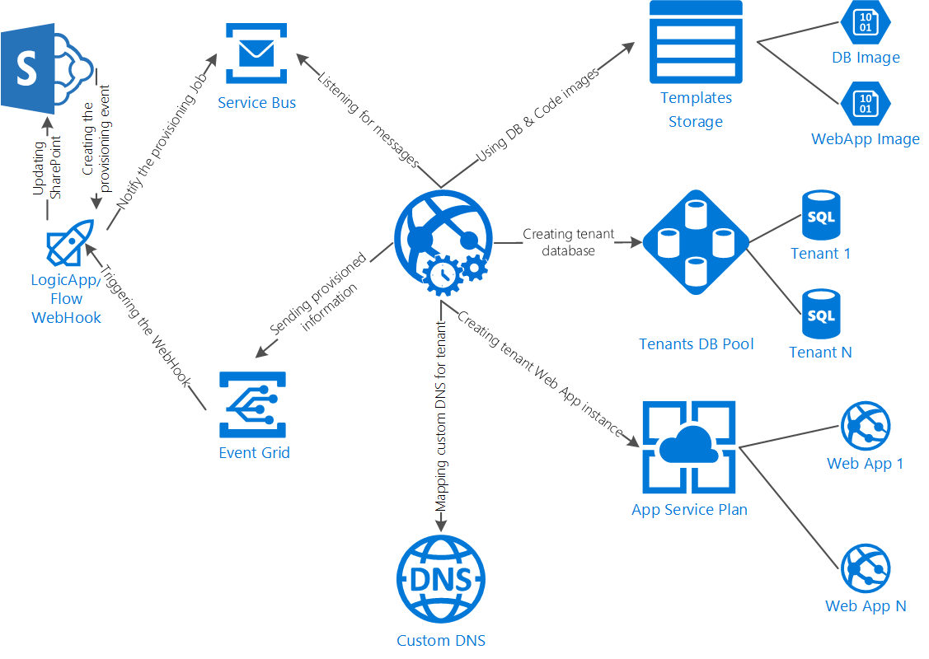

Slide 5
DEMO

Slide 6
Azure Management Libraries for Advanced Code-Based Automation
Roberto Freato
Consultant / Author / Solution Architect
Fabio Franzini
Independent Consultant / Trainer
Notes:
To add your image, please insert your picture and scale it to be bigger than the size of the white box shown.

